Slide 1

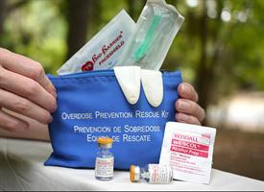
Opioid Overdose DeepGeeks
Sayed Khushal Shah
Zeenat Tariq
Sidrah Junaid
Syed Jawad Shah

Slide 2
Approach
Data Pre-processing
Statistical Model implementation
Dynamic visualization of Data
Tweets collection and selection of the top 5 states in United States where opioid overdose is trending

Slide 3
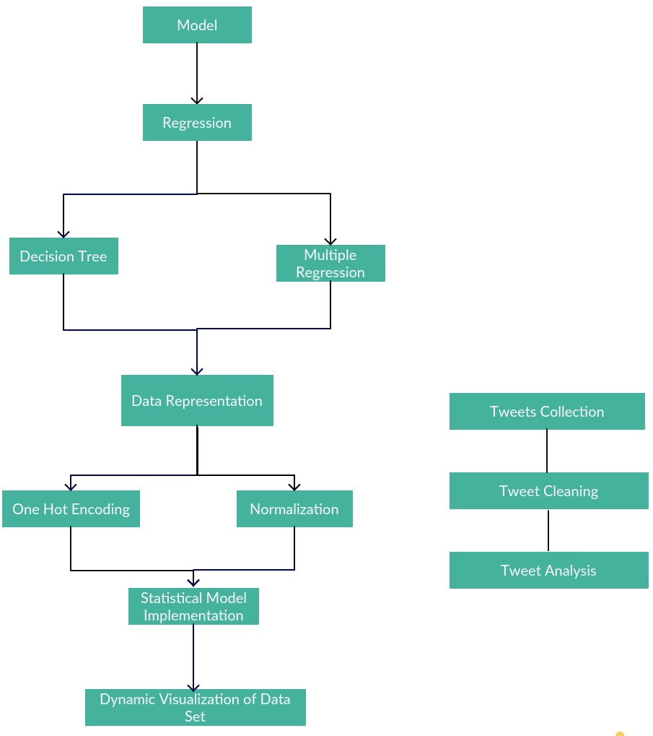
Architecture

Slide 4
Future work
Better mechanism for overdose prevention
Identifying the states that are at the risk of overdose epidemic
Applying this model to other drug misuse

Slide 5
References
https://www.cdc.gov/nchs/nvss/vsrr/drug-overdose-data.htm
https://twitter.com/api
www.shinnyapps.io/Rstudio
http://scikit-learn.org/stable/

